Slide 1
South East England Histology EQA scheme Digital Slide usage
Tuesday, August 18, 2015

Slide 2
41
Total Responses
Date Created: Thursday, July 23, 2015
Complete Responses: 41

Slide 3
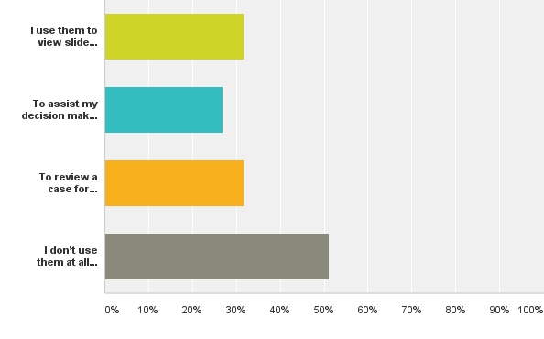
Q1: How do you use the EQA digital slides? (please tick all that appy)
Answered: 41 Skipped: 0

Slide 4
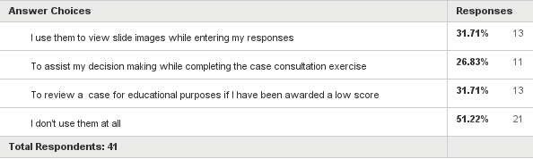
Q1: How do you use the EQA digital slides? (please tick all that appy)
Answered: 41 Skipped: 0

