Slide 1
South East England Histology EQA scheme AGM attendance 2016
Tuesday, March 15, 2016

Slide 2
54
Total Responses
Date Created: Wednesday, February 03, 2016
Complete Responses: 54

Slide 3
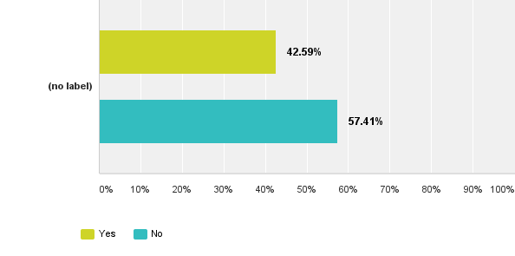
Q1: Have you ever attended the Scheme's Annual General Meeting?
Answered: 54 Skipped: 0

Slide 4
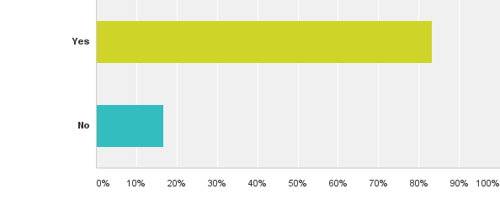
Q2: If you have attended, was it beneficial to you?
Answered: 24 Skipped: 30

Slide 5
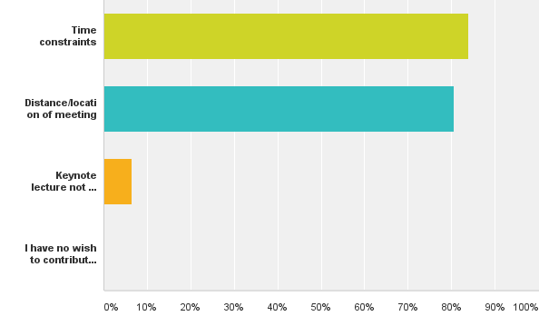
Q3: If you have never attended the AGM, please indicate why (tick all that apply)
Answered: 31 Skipped: 23

Slide 6
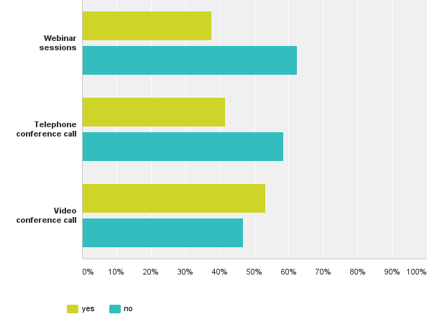
Q4: Do you have the facilities to participate in any of the following?
Answered: 52 Skipped: 2

Slide 7
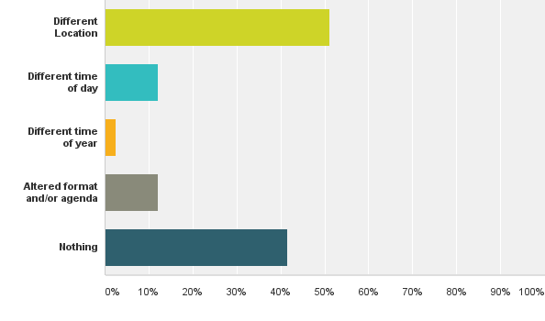
Q5: What else would facilitate your attendance at future AGMs?
Answered: 41 Skipped: 13

