Slide 1
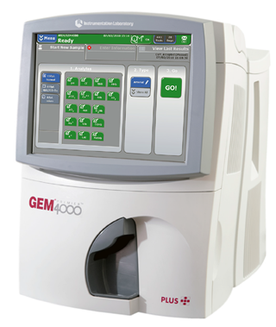
GEM4000 Blood Gas Analyser User
Updated August 19
RWF-POCT-TRAIN14 Revision 1.0

Slide 2
What is POCT?
“testing that is performed near or at the site of the patient with the result leading to possible change in the care of the patient”
“Use of POCT equipment by untrained staff, without adequate management supervision of the equipment and without the use of quality control procedures, can lead to misleading results, adversely affecting the treatment of patients.”

Slide 3
Gem 4000 Training
ISO 22870 states that training should include:
The name of the device and how to use it including sample collection
Theory of the measurement system (chemistry and detector)
Pre-analytical issues including storage conditions ?Room temp. or fridge
Your responsibility for checking the device
Any maintenance required and its frequency
Recognition of device failure and fault
What actions to take in the event of a failure or fault
Your responsibility for reporting problems with the device
Contact details to use in an emergency, including out of hours
The above needs to be documented - Appendix C

Slide 4
Health and Safety
To ensure H&S standards are met, the following guidelines apply:
Always label the patient’s sample prior to doing the test
Wash your own hands and put on gloves prior to testing a patient
Clean the outside of the Gem 4000 analysers with Clinell wipes
The grey sampling area should be cleaned then rinsed with water and dried
The GEM4000 probe is self-cleaning – only use water if required
Dispose of used syringes and needles in accordance with the Trust Waste & Infection Prevention & Control policies

Slide 5
Blood Gas
pH and pCO₂, HCO₃–, and TCO₂, define the acid-base status of the patient
Arterial pO₂ indicates if there is adequate oxygen available to body tissues
Sodium is the major positive ion in extracellular fluid - osmotic pressure and body water distribution
Potassium is the major positive ion in intracellular fluid - including respiratory & myocardial actions
IONISED calcium is critical for multiple functions - including neuromuscular actions
Chloride is the major negative ion in extracellular fluid and often reflects sodium concentrations
Hematocrit is the percentage of the total blood volume that is occupied by red blood cells
Glucose is the primary energy source. Poor control may occur in diabetes, severe illness and shock
Lactate is produced during carbohydrate metabolism. If cells lack oxygen, lactate levels may rise
Total bilirubin is the sum of two bilirubin fractions, unconjugated and conjugated. Raised levels of bilirubin may be seen as jaundice in the skin and eyes of a patient
Co-oximetry (tHb, O2Hb, COHb, MetHb, HHb, SO2) evaluates the ability of blood to carry oxygen by measuring the total haemoglobin and the percentages that are bound to oxygen or that are blocked by chemicals such as carbon monoxide or drugs

Slide 6
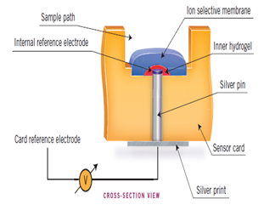
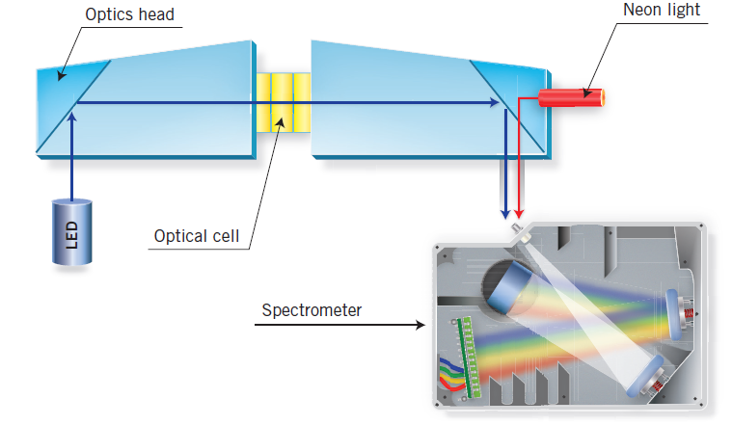
How Does it Measure?
Potential difference
(pH, Na, K, Cl, IONISED Ca, glu, lact, pO₂, Hct)
Optical absorbance
(tHB, O₂Hb, COHb, HHb, sO₂, tbil)
You do not need to memorise this - it is just to show there is a lot going on!

Slide 7
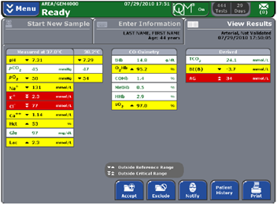
Test Menu
Measured values
pH, pO₂, Na, K, Cl, IONISED Ca, Glu, Lact, Hct
Temperature corrected values
Used in some areas e.g. ITU and correct only if the true current patient temperature is entered in the temperature information field
Co-oximetry values
tHB, O₂Hb, COHb, HHb, sO₂, tbil
Derived values
Calculated using equations applied to one or more measured values e.g. TCO2, BE(B), HC0₃⁻

Slide 8
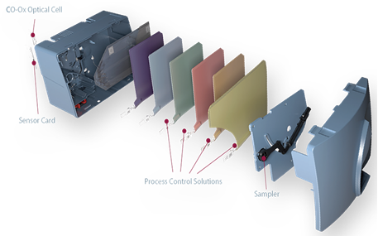
Cartridges
Obtained from Integra
Store at 15-25°C
Stable until the expiration date listed on the package
Once loaded onto the analyser the cartridge has a maximum onboard life of either 21 or 30 days, or is removed when all the tests are used

Slide 9
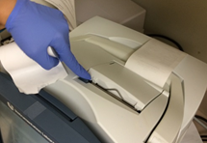
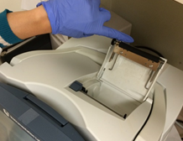
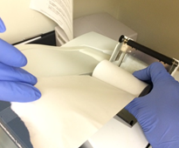
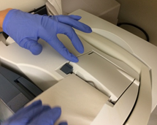
Installing Printer Paper
Press the tab at the top of the system to release the door
Open the door
Place the roll of paper in the compartment so that the paper unfurls from the bottom
Press the door firmly closed

Slide 10
iQM
Intelligent Quality Control Management
Monitors the performance of the system in real-time after every sample
Identifies the potential failure patterns
Automatically performs corrective actions
Automatically documents the failure and the corrective action taken

Slide 11
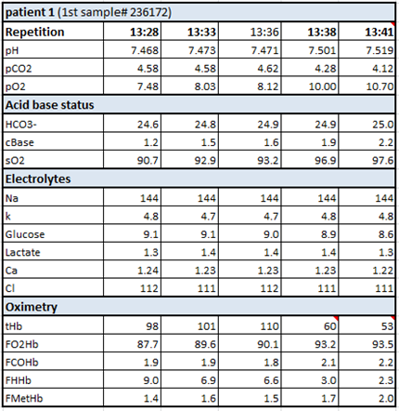
Results Change Over Time
13 minutes
pH 7.468
pCO₂ 4.58
pO₂ 7.48
sO₂ 90.7
Gluc 9.1
tHb 98
O₂Hb 87.7
COHb 1.9
7.519
4.12
10.70
97.6
8.6
53
93.5
2.2

Slide 12
Limitations
Only arterial, venous, capillary, and cord bloods are acceptable specimens
Air contamination (bubbles or transfers) pO₂ pCO₂
Delay between collection & testing pO₂ pCO₂ Gluc standard metabolism
Raised WBC increases the speed of metabolic changes
Poor mixing impacts cooximetry causing false pos/neg anaemia
Un-heparinised syringes - clotting causes failed testing/damages cartridge
Haemolysis can significantly increase the potassium result
Heparin concentrations of more than 15 IU/mL can cause binding of Ca²⁺ Na⁺ and to a lesser extent K⁺ which may lead to lower than true results
Always consider the result obtained - does it match the clinical picture?

Slide 13
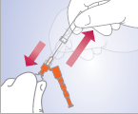
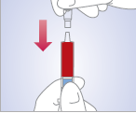
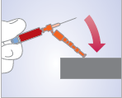
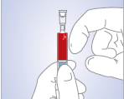
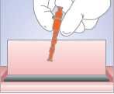
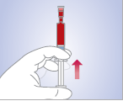
Syringes
Remove needle sheath to collect blood gas sample
Insert filter
On a hard surface press the needle into the safety cap until it clicks
Tap syringe to move air bubbles to the top
Dispose of needle in sharps bin
Expel air then gently mix continually until analysis

Slide 14
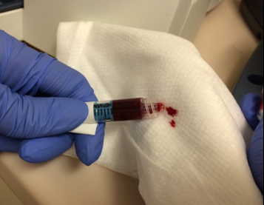
How Much Blood?
Syringes - Minimum blood volume is:
At least 0.80 mL in a 3 mL syringe
At least 0.25 mL in a 1 mL syringe
Just before analysis mix the sample by rolling between the palms of your hands followed by repeated inversion, then remove filter and push out a few drops of blood onto a pad or tissue to check for clots in the syringe tip
Capillaries - Aim to completely fill the heparinised tube
Sealed by end caps if available, mix by rolling between finger & thumb
Avoid mid-sample bubbles - liquid sensors may reject as a short sample Cap, hold vertically, gently tap bubbles to top, present lower end to analyser
Remove both end caps prior to sampling

Slide 15
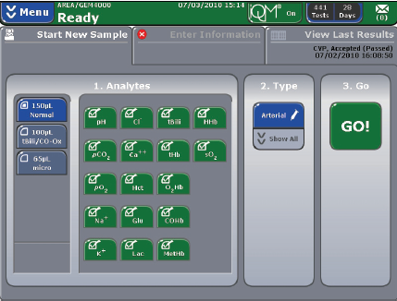
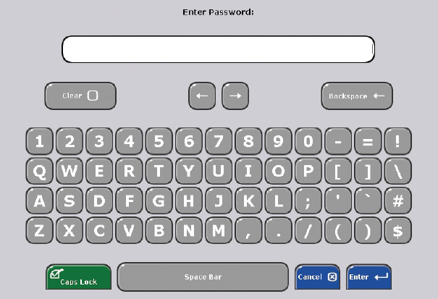
Patient Testing
Samples should be labeled with patient ID
The default test menu is blue in screen zone 1, touch to change if required
Select sample type in zone 2 by using ‘Show All’ drop-down for venous, capillary, cord or CVP
Press GO!
Scan your personal barcode or type your pin and press enter
It is against Trust IG & POCT Policies to share personal access codes

Slide 16
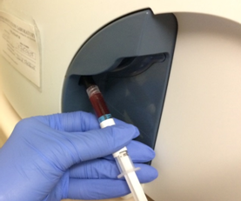
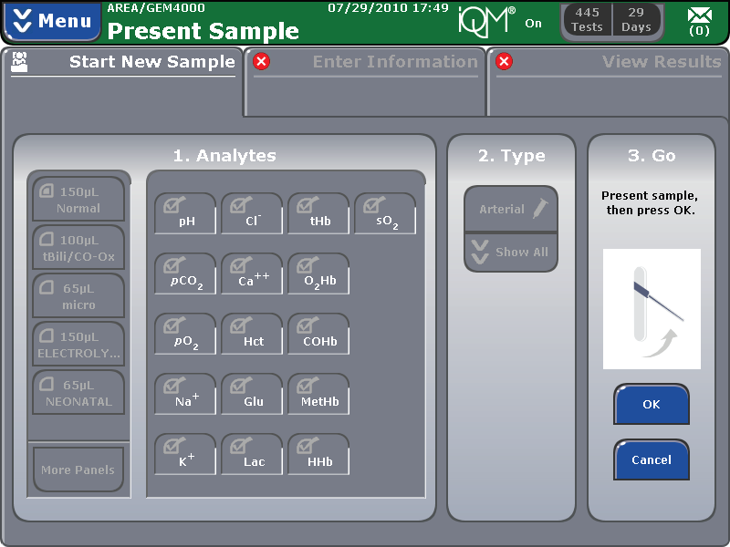
Syringe
A blunt metal probe will slowly pivot down wait until it is stopped - do not obstruct
Screen prompts ‘Present Sample then press OK’
Position the sample over the probe far enough in for aspiration without air, but not so far that the probe touches the bottom and then press OK
A double beep and ‘Remove Sample Now’ on screen prompts that aspiration is complete
Remove sample and press OK to retract the probe
If OK is not selected within 15 seconds of the alarm the probe will automatically retract A count-down timer is displayed

Slide 17
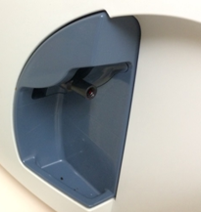
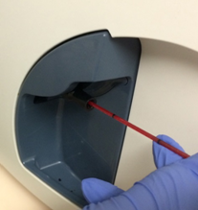
Capillary
The luer tip will present just below the home position (the sampler will not extend)
Wipe the end prior to placement if there is blood or debris on the outside of the capillary tube
Tilt the tube slightly until the blood is flush with the end of the capillary tube. Place one end of the capillary tube in the luer tip
Hold the tube end but do not use excessive force
Press OK to begin aspiration
A double beep and ‘Remove Sample Now’ on screen prompts that aspiration is complete
Remove sample and press OK to retract the probe

Slide 18
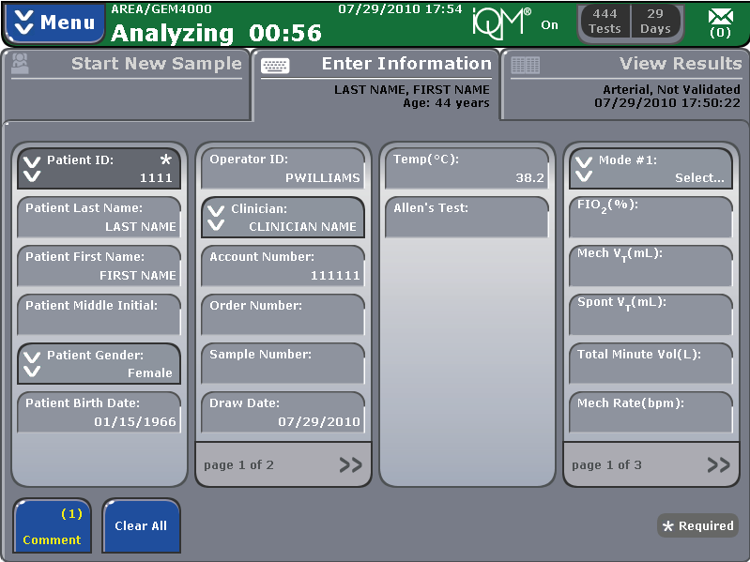
Identifying the Patient
Identify the patient during analysis
Touch Patient ID: and then type or scan the barcode from patient notes
If previously seen an option to select the correct patient is given
If the correct details do not appear enter all information manually
 is a mandatory field and must be completed before results can be viewed
Please Note: It is against Trust IG & POCT Policies to intentionally misidentify patients
This can compromises patient safety and opens the Trust to legal liabilities
Use of random identifiers may result in operator access codes being deactivated
**The Althea rule applies

Slide 19
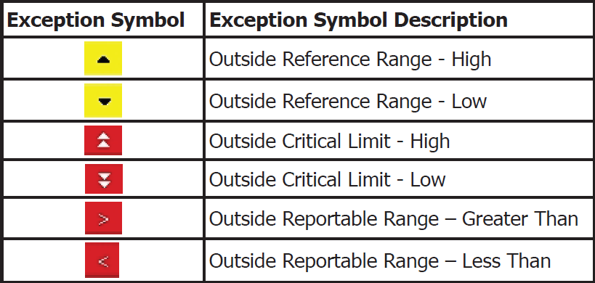
Results
Select View Results
Press Accept for print out
Results must be entered into the patient notes and acted on appropriately
Notes:
An example of a result within the reading rage of the meter
An example of a result out with the reading rage of the meter.

Slide 20
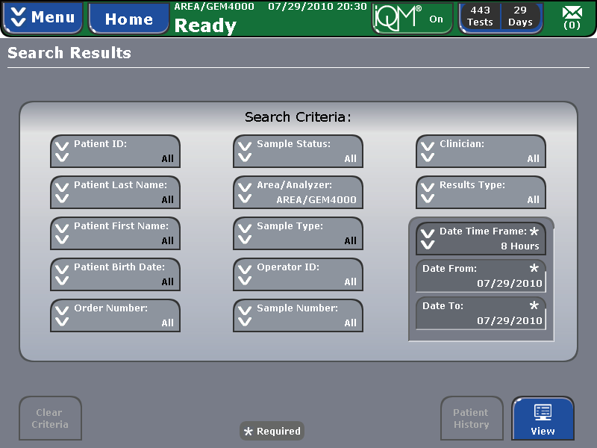
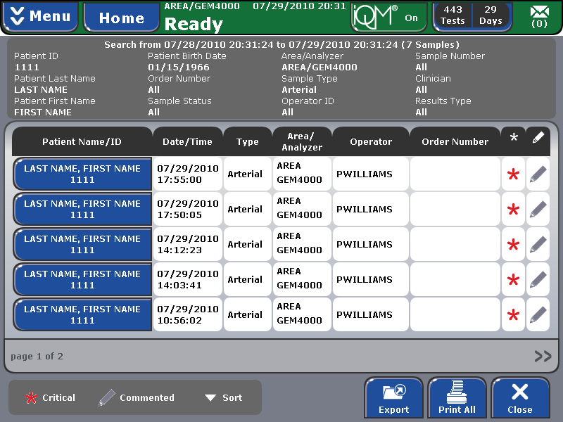
Reviewing Past Results
Select Menu
Select Search Results
Put in your personal code and press Enter
Search by single or multiple criteria
If result not found consider minor transcription errors and reduce the number of criteria
A maximum of 500 results from EVERY analyser are shown unless limited by criteria
Touch to view the selected result
Re-print correctly identified results ONLY
If in any doubt about identification DO NOT use the result clinically
Notes:
The CoaguChek XS Plus meter can save 2000 patient test results as well as 500 liquid quality control tests
Select “Review Results”
Select the type of result you want to review either:
“Patient Result” or “QC Result”
The following buttons for general use are located in the views described below:
Menu icon: Return to main menu
Return icon: From the single-result display, return to the list of results
Individual icon: List that contains entries for this patient only.
(Note of caution using this function as this may not contain a complete history of the patient results as they may have had an INR test carried out elsewhere)

Slide 21
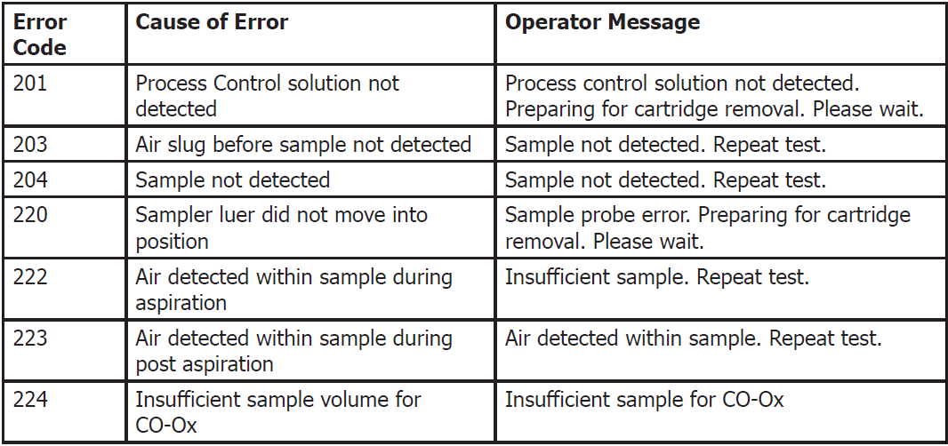
Error Messages
Notes:
Examples of Error Messages
Error 401, 402, 403: Usually indicate that meter is struggling to detect the blood sample. This can usually be resolved by cleaning under the chamber measurement cover as per the cleaning instructions
Error 405 & 406: Relates to the blood sample itself. These errors can be caused by poor technique for obtaining the sample or an issue with the patients blood e.g. low haematocrit and you should review the pack insert.
Error 406 On rare occasions can indicate >8 INR
Error 407: Failed onboard QC. Visually inspect next strip prior to test. Reagent in test strip channel should be blue. If pink/purple use a strip from another container

Slide 22
Standard Cleaning
Do not use sprays and ensure that wipes are only damp not wet
Clean the exterior of the analyser using Clinell wipes
Wipe down the bottom of the cartridge bay using Clinell wipes but avoid the probe port and luer tip where water only may be used
Do not let liquid accumulate near openings to ensure that no cleaning liquid enters the analyser
Clinell wipes can leave residue that makes the screen unresponsive. Use a cloth or lint free tissue dampened with water to wipe away any moisture after cleaning the screen
If contamination with very high risk infectious agents is suspected contact POCT for additional guidance (e.g. Ebola etc.)

Slide 23
External Quality Assurance (EQA)
iQC is automatically checked by the GEM4000 after every patient sample
EQA is testing of samples with unknown values from an external source
Performed for all tests on all of the 9 Trust analysers
Samples are analysed every month and reported on-line
Results are immediately compared between the 9 Trust analysers to identify if any are out of consensus
Results are compared nationally across different NHS sites to identify analyser trends that may identify manufacturing issues
Reports are reviewed within the Pathology Quality Governance system

Slide 24
Clinical Incidents
If a Clinical Incident involving a POCT device has happened or is suspected:
Identify the exact device and consumables used
Quarantine by attaching a sticker or putting everything into a clearly marked bag to ensure it is not used again by a colleague
Phone EME to report
Remember to include the device serial or asset number in the Datix report

Slide 25
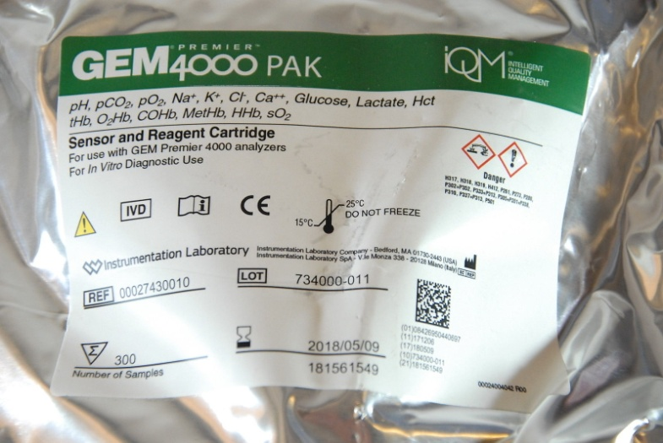
Gem 4000 Support Team
Your MTW Gem 4000 support teams are:
EME
Breakdowns
Integra
Consumables
Cartridges, CVPs, Paper
Syringes and Capillaries
POCT Team - Email mtw-tr.POCT@nhs.net
Advice and support if incorrect results are suspected, EQA management
New POCT Intranet page now available

Slide 26
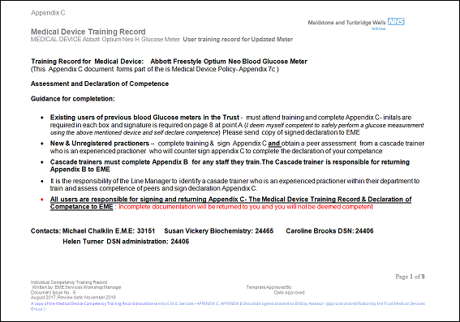
Trust Documentation
You have a training record to complete
Please read and initial each point
If you are not sure or feel something may have been missed please ask
Experienced registered practitioners can sign themselves as competent
New / Unregistered Practitioners require a peer signature to confirm competence
All users are responsible for completing and returning their Appendix C document to EME

Slide 27
Any Questions?

